Slide 1
Learning Objectives:
Maximum of 3 hard ICT skills
E.G To be able to use IF THEN ELSE code blocks
Notes:
No soft skill objectives e.g To be able to work as a group, To be able to plan

Slide 2
Do it now task
Examples:
Log into devices and check wifi settings
Open project or given app
Notes:
This could

Slide 3
Knowledge retrieval task
Examples:
Fix this broken code
List 3 examples of …..
Complete the sentence or fill the gaps
Notes:
If this is a new project use this as a KWL grid to assess what the children already know about a topic

Slide 4
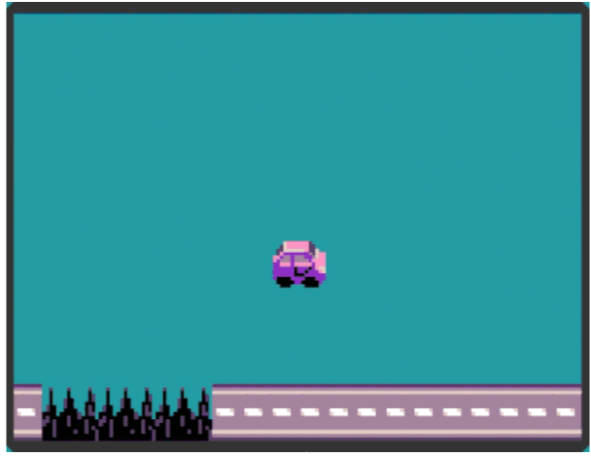
PRIMM
In pairs talk about the following:
Objective of the game
Controls
Win & lose limits
Notes:
Predict, Run, Investigate, Modify, Make.
This slide is crucial, it’s a flipped learning approach when encourages the children to work backwards from expected outcome. Predict what will happen in the game using the prompts as scaffolding to the discussion.
Provide links to completed projects or video of completed project to use as a WAGGOLL

Slide 5
Predict, Run, Investigate, Modify, Make.
Break down teaching of individual skills or concept into manageable chunks. 4 steps, scaffolded with visual aids.
MODEL MODEL MODEL with an audio description of what you are doing, explaining why you doing it
Encourage buddy coding, checking and testing throughout their application of skills
PRIMM

Slide 6
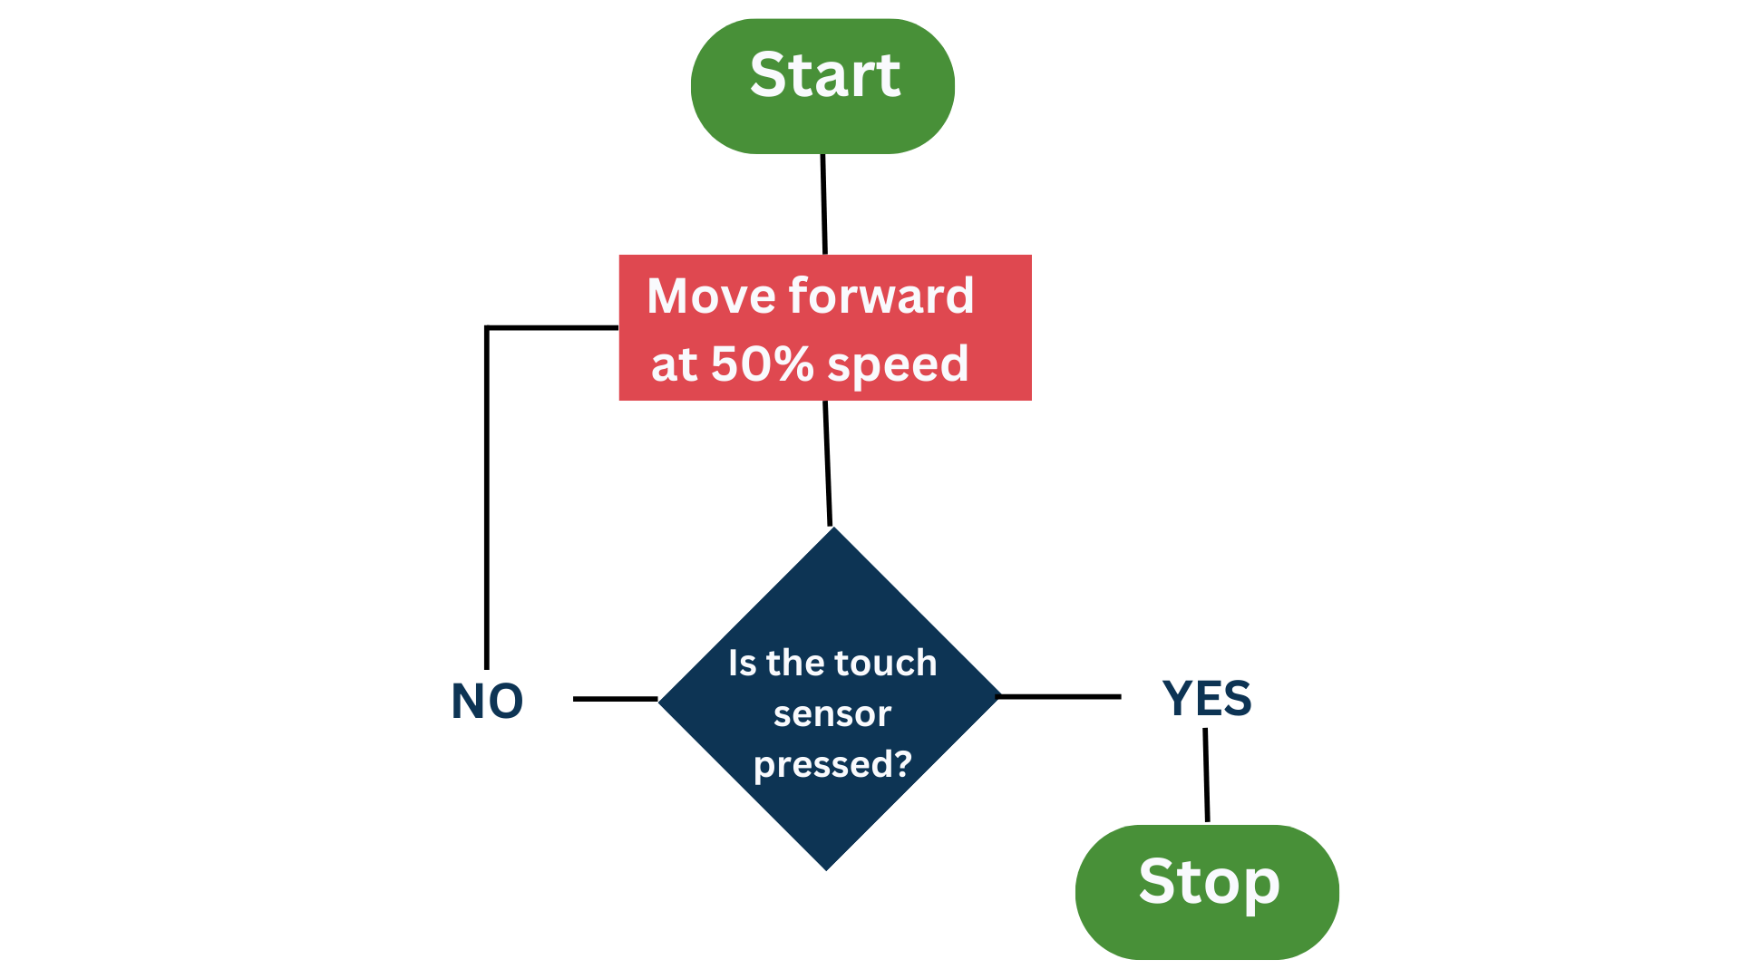
Visual representation
What will this program make the robot do?
PRIMM
Notes:
Where applicable the use of visual representations of coding concepts should be used to scaffold key concepts

Slide 7
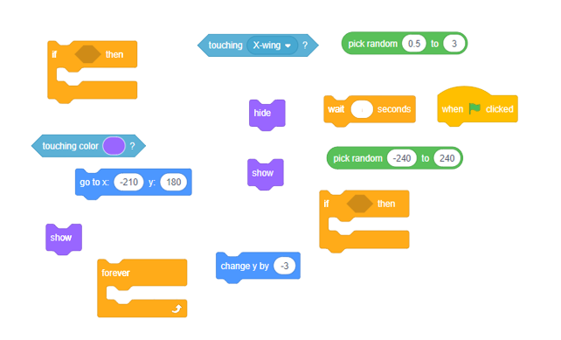
Parsons Problem Scaffolding
Notes:
Use deconstructed problems to visually scaffold the coding concept.
Higher ability children code without limitations
MA/LA can buddy code to piece together

Slide 8

Debugging your game
In pairs test your game to find any bugs (glitches) and fix them. Your game should run smoothly.
Notes:
Allow evaluation and modify time for students in the sequence of teaching

Slide 9

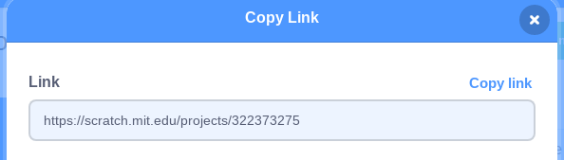
Share
Evaluate
Click the orange share button and copy the LINK to your game
Paste your game link to the Seesa activity and complete the evaluation tasks.
Notes:
Plan adequate time for sharing and evaluating work on seesaw or other platforms. This should not be a throwaway task and should take a minimum of half a lesson.
Peer assessment and self reflection of work is crucial at the end of units

Slide 10



Whole class feedback
You have used the XYZ concept to code your game to do ABC
You must always test and debug your game so it runs smoothly
Always name your sprites and backgrounds
Notes:
This is an example whole class feedback sheet to use ¾ through a unit.
Green- What are the whole class secure in using
Orange- on average what is the common misconception that needs addressing
Pink- What is common mistake that shouldn’t be happening but isn’t part of the new learning cycle. This error is caused by carelessness or lack of focus.

